Slide 1


Intrinsic Evaluation of Summarization Datasets
Rishi Bommasani
Claire Cardie
EMNLP 2020 KEYNOTE!!!

Slide 2

Revisit
Summarization Data

Slide 3
Ensuring data quality
- Crowdsourcing practices
NLVR, NLVR2 from Yoav Artzi’s group at Cornell
Several commonsense datasets from Yejin Choi’s group at UW/AI2
Adversarial filtering, human-in-the-loop generation
- WMT
- Penn Treebank

Slide 4
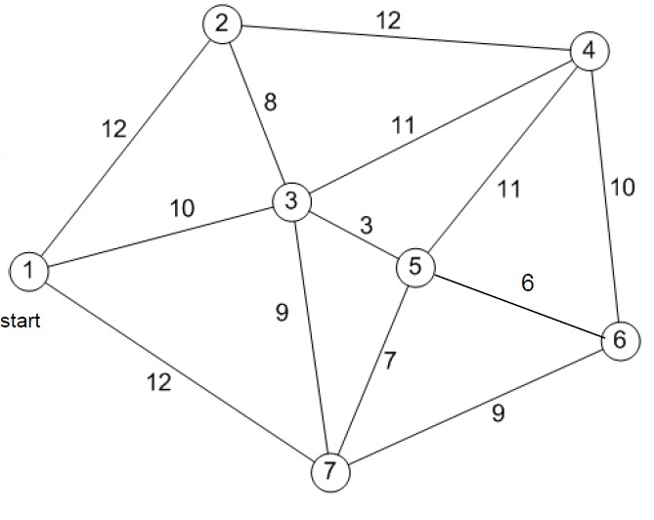
Is evaluating data quality easy?
Travelling Salesman Problem
Find shortest cycle that starts and ends at 1, such that you reach every vertex.
NP-Hard

Slide 5
Is evaluating data quality easy?
Trav. Sale. Decision Problem
Does there exist a solution to TSP of cost at most L?
NP-Hard

Slide 6


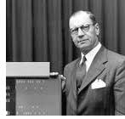
What do we do?
- Identify important aspects of summarization data
- Measure each of these aspects

Slide 7
Properties we measure
Compression (CMP)
Abstractivity (ABS)
Topic Similarity (TS)
Redundancy (RED)
Semantic Coherence (SC)

Slide 8
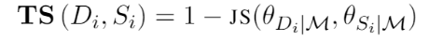
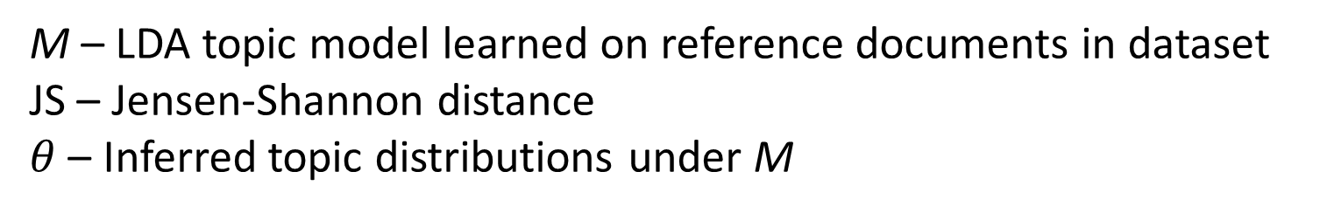
A taste of the measures: Topic Similarity
M – LDA topic model learned on reference documents in dataset
JS – Jensen-Shannon distance
$θ$ – Inferred topic distributions under M

Slide 9
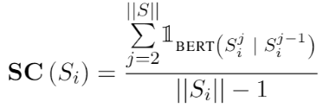
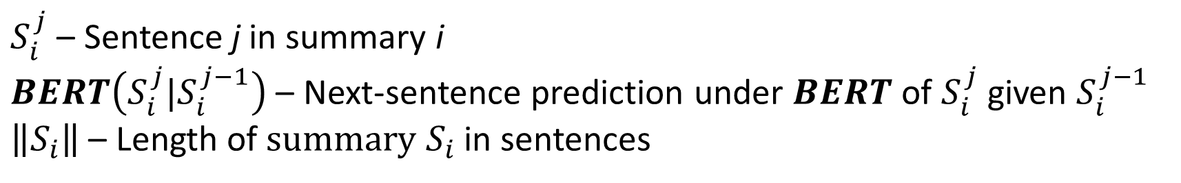
A taste of the measures: Semantic Coherence
$S_{i}^{j}$ – Sentence j in summary i
$BERT\left(S_{i}^{j}|S_{i}^{j−1}\right)$ – Next-sentence prediction under $BERT$ of $S_{i}^{j}$ given $S_{i}^{j−1}$
$\left\|S_{i}\right\|$ – Length of $summary S_{i}$in sentences

Slide 10
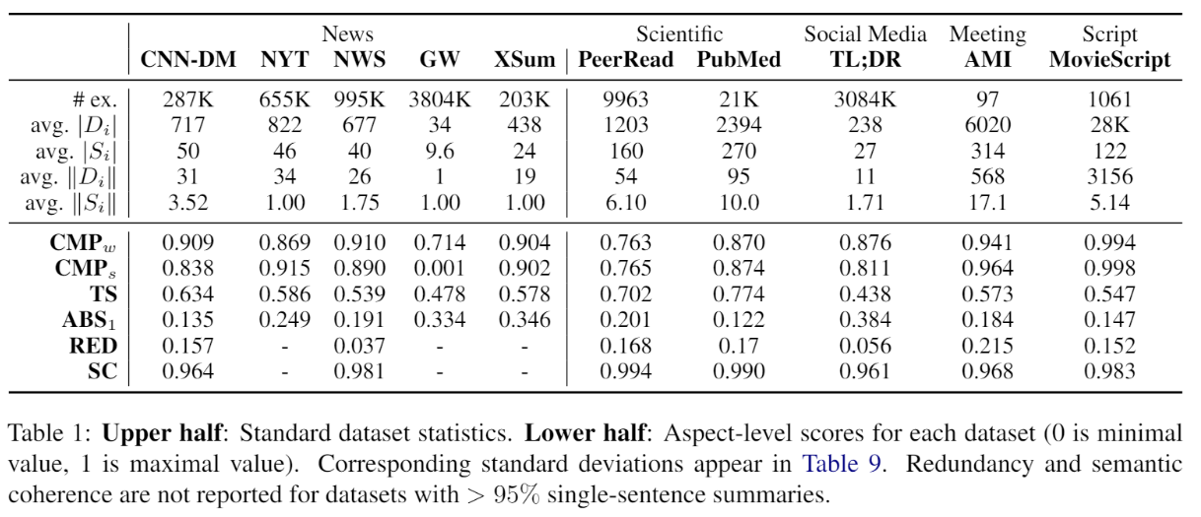
Compression captures dataset type

Slide 11
Mismatch between dataset and modelling (abstractive vs. extractive)

Slide 12
Since datasets feature significant redundancy, we may need to post-process to deploy systems

Slide 13
Extra Results in Paper
Pairwise correlations between metrics
Standard deviations for metrics
Other metrics we tried for measuring same properties

Slide 14
What happens for “extreme” examples
Extreme – Top or bottom 10% of examples in a given dataset for a given metric
Manually examine several hundred such examples
Noticed that extremes often correlate with being generically low quality (for a conservative notion of low quality)

Slide 15
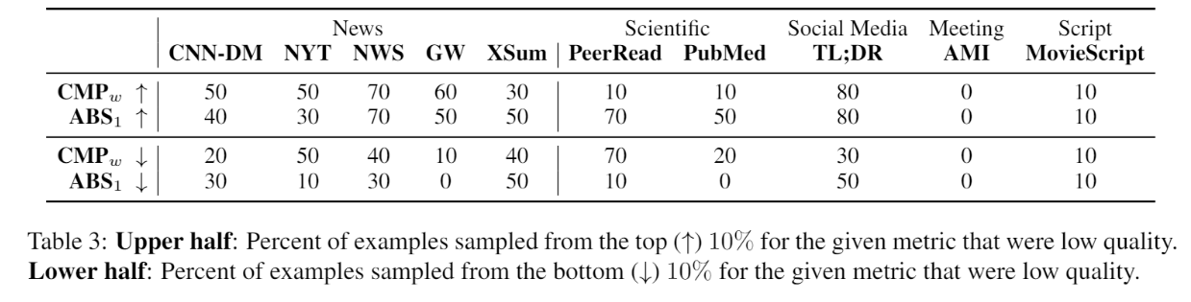
Fraction of low quality examples

Slide 16


Slide 17
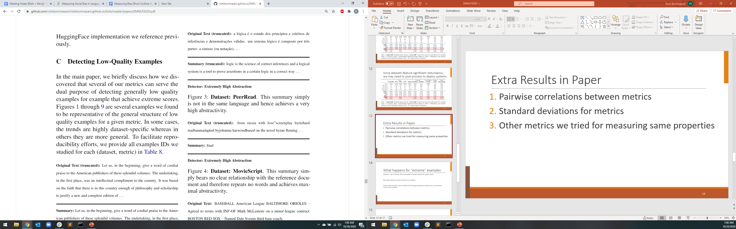
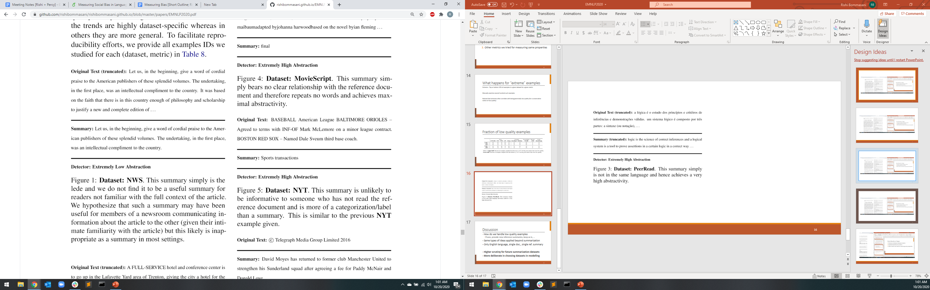

Slide 18
Discussion
- How do we handle low quality examples
Prune, provide new reference summaries, keep as is, …
- Same types of ideas applied beyond summarization
- Only English language, single doc., single ref. summary
- Higher scrutiny for future summarization datasets
- More deliberate in choosing datasets in modelling

